Slide 1
Assessing Risk - Competition and Data
Lecture 4
Yuhan Fan

Slide 2
Objectives
Understand competition among contemporary enterprises
Apply quantitative techniques to assess risks
Calculate risk exposure and mitigation thresholds

Slide 3
Why quantify competitive risk?
“In business, the competition will bite you if you keep running; they will swallow you if you stand still.”
“War is ninety percent information.”
Key questions:
What’s the probability our market share drops below X% due to Competitor Y’s new product?
How much budget reserve is needed to counter supply chain disruptions?

Slide 4
Reasons behind the increased competition among contemporary enterprises:
Explosion of access to cheap and fast information
Maturation of industries and businesses
Loss of traditional means of competitive structuring and advantage
Sophisticated and better-informed consumers
Dynamic and rapidly evolving technology

Slide 5
Contemporary Context Facing the Analyst:
Lack of recognition that analysts are mission-critical
Decision makers cannot always articulate their decision needs
Pressure for a quick judgment
Highly ambiguous situations
Incrementally received/processed information

Slide 6
Case examples:
Tesla vs. legacy automakers
Streaming wars: Disney vs Netflix

Slide 7
Tesla vs. legacy automakers
Tesla:
Model Y became the world’s best-selling car in 2023
Cutting-edge battery technology, unmatched Supercharger network, and seamless over-the-air software updates
Legacy automakers:
Ford: F-150 Lightning & Mustang Mach-E
Volkswagen: ID.4
Hyundai, Kia

Slide 8
Streaming wars: Disney vs Netflix
Disney’s Rise & Impact:
Launched in late 2019, quickly rivaled Netflix & Amazon Prime Video.
Aggressive Pricing: Started at $6.99/month (vs. Netflix’s $9.99), leveraging Disney’s diversified revenue (theme parks, films).
Strategic Acquisition: Acquired Hulu, expanding market share.
Pandemic Boom: 58% of users increased paid streaming during quarantine.

Slide 9
Streaming wars: Disney vs Netflix
Netflix’s Defensive Moves:
Promised one original movie per week in 2021 to compete (no major price hike).
Focused on volume over pricing, likely to retain subscribers amid Disney+’s growth.
Market Pressure: Disney+’s low-cost model forced Netflix into defensive tactics.

Slide 10
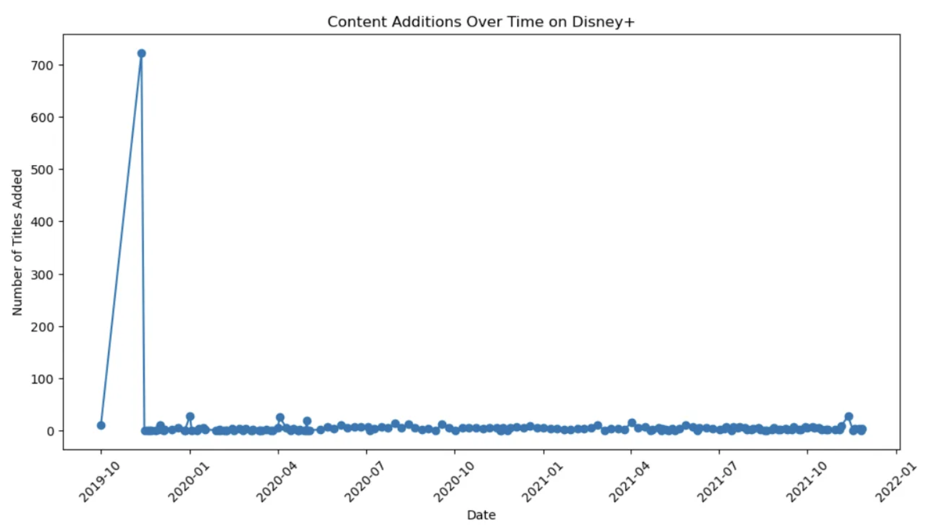
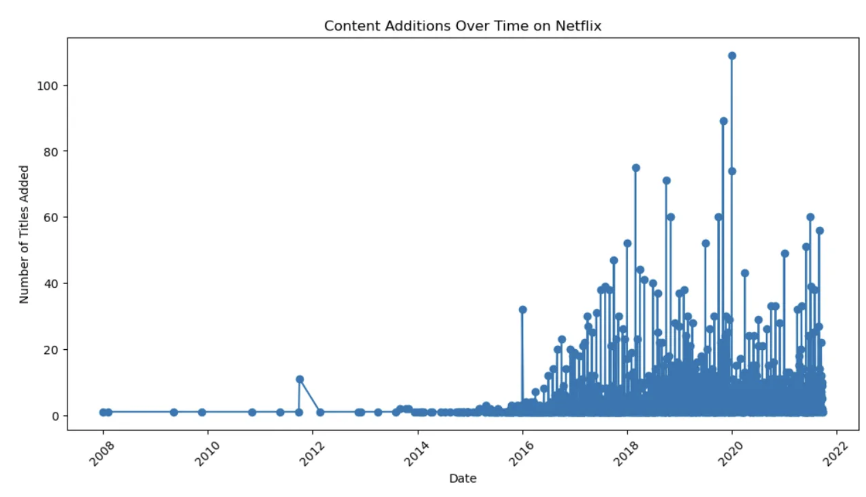
Streaming wars: Disney vs Netflix

Slide 11
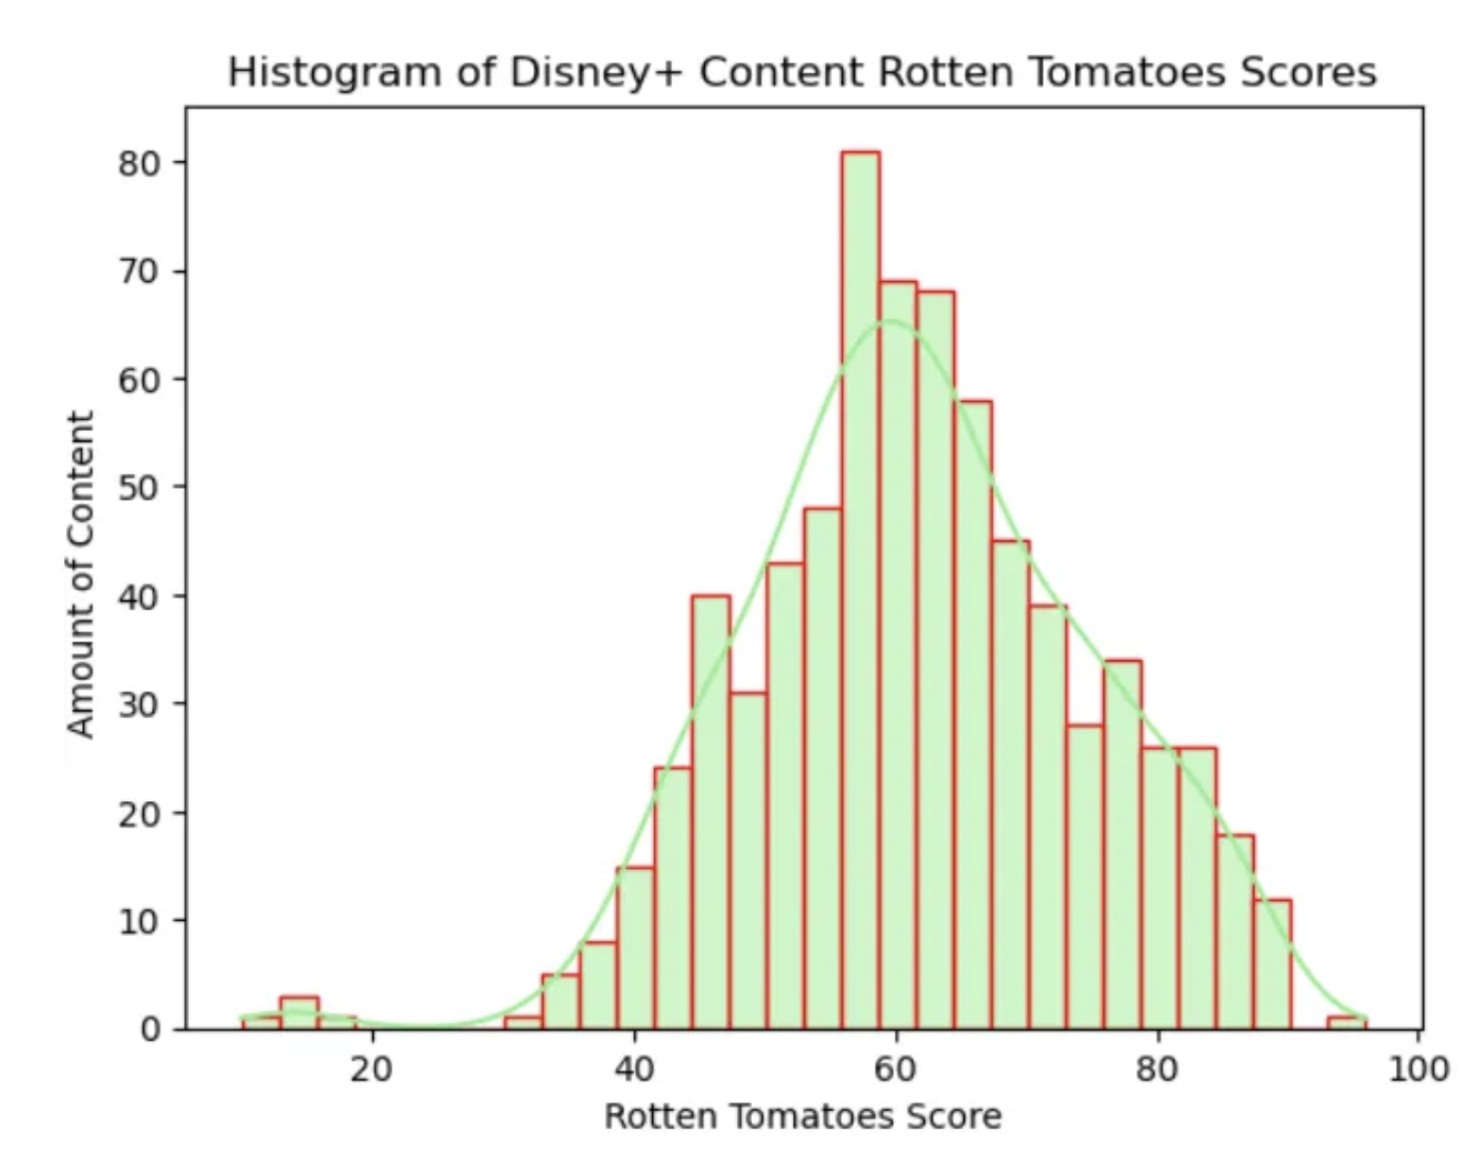
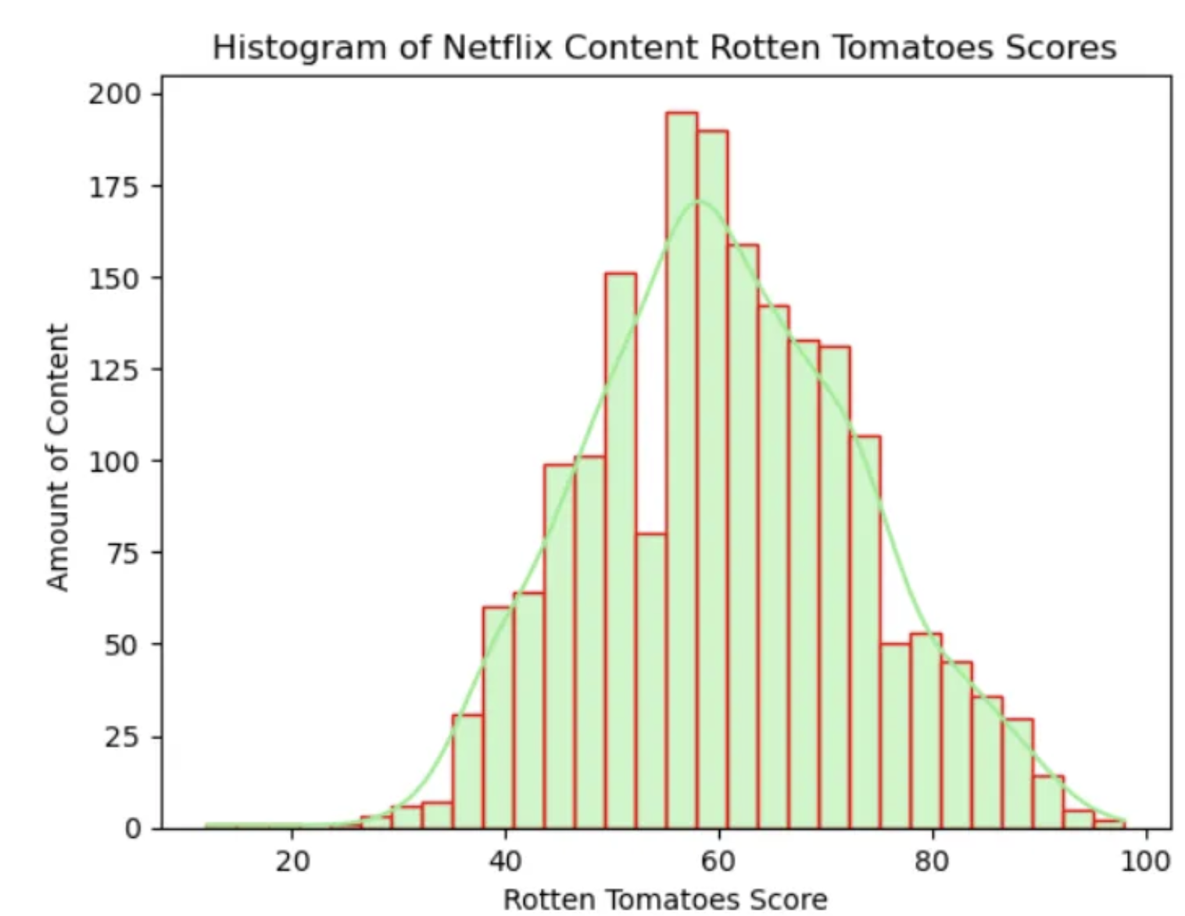
Streaming wars: Disney vs Netflix

Slide 12
Quantitative Risk Assessment Techniques
Uses mathematical models and data analysis to determine the likelihood and potential impact of risks, and how to mitigate them.
Data:
Structured data inputs:
Historical competitor entry data (market, region, time, success/failure)
Economic indicators, market share, products pricing
Unstructured data inputs:
News articles, earning calls, press releases
Expert reports, industry whitepapers
Analytics Tools:
Python libraries (PyMC3 for Bayesian networks, scikit-learn for regression risk models).

Slide 13
Quantitative Risk Assessment Techniques
Probability Analysis:
Likelihood of risk events (e.g., competitor entry, pricing wars) using:
Historical data (Bayesian inference)
Expert calibration (Delphi method)
Beta distributions

Slide 14
Probability Analysis
A company is concerned about the risk of a competitor entering its market.
They use historical data to analyze past instances of competitor entry and identify factors that influenced the likelihood of success. Then, they use Delphi method to gather expert opinions from industry analysts and management on the current market conditions and their impact on the likelihood of a competitor entering. Finally, they represent the overall probability of competitor entry using a beta distribution, which would allow them to estimate the range of possible outcomes and prepare mitigation strategies accordingly.

Slide 15
Quantitative Risk Assessment Techniques
Modelling & Financial Metrics
Monte Carlo Simulation
Decision Tree Analysis
Expected Monetary Value (EMV)
Sensitivity Analysis
Three-Point Estimate
Bow Tie Analysis
Scenario Analysis
Failure Mode and Effects Analysis (FMEA)
Fault Tree Analysis (FTA)

Slide 16
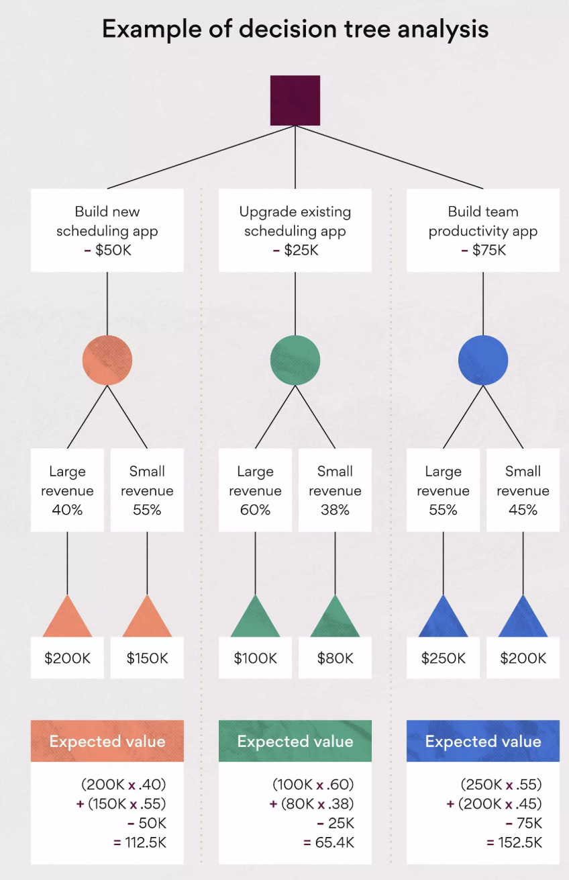
Decision Tree Analysis
This approach uses a branching diagram to represent different decisions and their potential consequences, allowing for a systematic analysis of risk.
It can help visualize the impact of various choices and identify potential risks at each stage of a process.

Slide 17
More demonstration…
Expected Monetary Value (EMV)
Sensitivity Analysis

Slide 18
Risk Management Techniques
Acceptance
Mitigation
Avoidance
Transfer

Slide 19
Risk Transfer
Financial instruments like options, futures, and insurances can be used to reduce and transfer risks that are undesirable for a firm.
A portfolio view of risks helps to assess the combination of financial products that provide most cost effective solution to the risk reduction and transfer problem.
Integrated risk management helps to use natural hedging strategies that exists in the risk portfolio.
Firms should structure its business policy to reduce accumulation of high amounts of risk in certain areas where risk adjusted returns are not promising.

Slide 20
Risk Exposure
Value at Risk (VaR) :
VaR is used to estimate the maximum potential loss of an investment or portfolio over a specified time period and at a given confidence level.
It's a way to quantify the downside risk of an investment
Demonstration in class…
Conditional Value at Risk (CVaR) :
It measures the average loss expected beyond a certain threshold, often the Value at Risk (VaR).
It's essentially the expected shortfall, meaning the average loss given that a loss exceeds the VaR level.

Slide 21
Risk Mitigation Measures
Contingency Planning:
Reserve analysis
Contingency=Risk Exposure×Mitigation Efficacy
Optimization:
Portfolio rebalancing (Markowitz) to minimize competitor concentration risk.
Demonstration in class…

Slide 22
Thank You !

